Slide 1

Team Love - Pretty Near
Milestone 2
Jingwen Low
Julian Wilkinson
Rishi Dutta
Shraddha Agrawal

Slide 2
Agenda
Changes since the last Milestone
User Personas
Database Schema
Demo

Slide 3
Changes since
the last Milestone

Slide 4
Changes since Milestone 1
Switched to MySQL
Google AppEngine does not support SQLite
Excluding the Camera feature
For the scope of our project, implementing a Camera API is not the focus so for the time being we are “emulating” it by just allowing users to choose photos

Slide 5
Milestone 2
User Personas

Slide 6
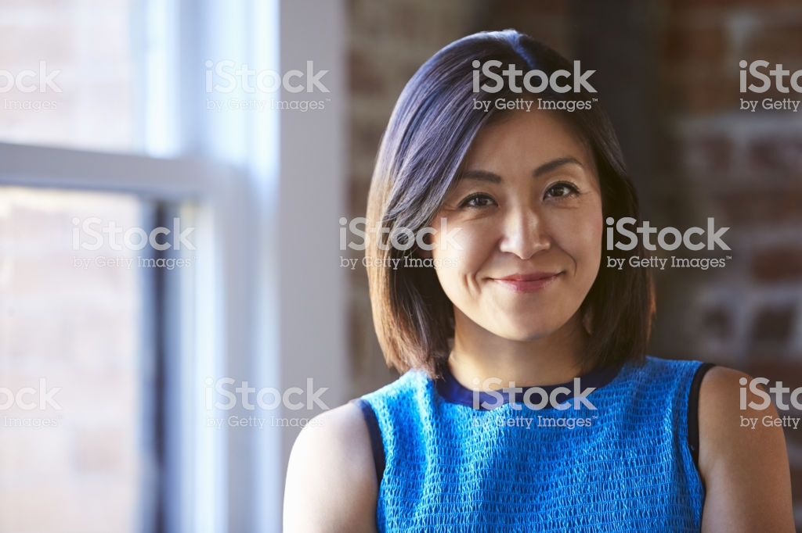
Vivian
Software Engineer at Slack
26 years old
Single
Lives in San Francisco
Stable career in tech
BS in Computer Science from The University of California, Davis

Slide 7
Vivian
Vivian spent much of her time in college studying and furthering her career. Because of this, she never got around to dating anyone. Now that she is finally in a place where she wants to be with her career, she is looking forward to meeting new people and potentially being in a relationship
Vivian spends her time:
Working from 9 am - 5 pm
Going to gym in the evening
Hiking on weekends

Slide 8
Vivian
Vivian should be able to:
Find potential matches who are in the same situation
Feel secure and in that she can report others if need be
She is comfortable using apps and has a drive so doesn't have issue travelling.

Slide 9
Vivian
“Can I safely find the one on this app and will they be relevant to my life?”

Slide 10
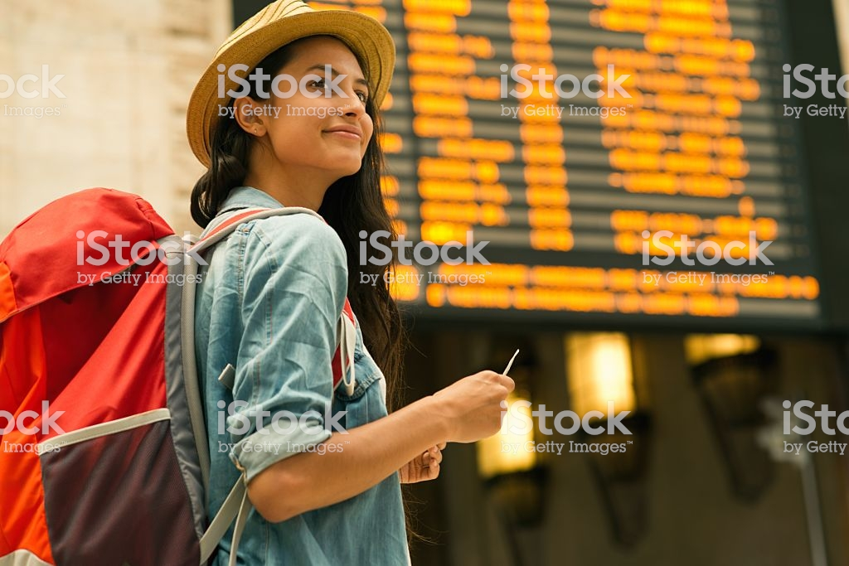
Tanya
Traveller who recently graduated
23 years old
Single
From Spain
Recently got her Master’s degree

Slide 11
Tanya
Tanya just finished her Master’s degree and is feeling adventurous so she decided to travel solo in the United States. Hoping for spontaneous fun and new people, Tanya would love to connect with those around her
Tanya spends her time:
Travelling
Meeting new people
Understanding the culture of the new places

Slide 12
Tanya
Tanya should be able to:
Meet new and fun people
Know that those that she meets are are not problematic
She is comfortable using apps but cannot travel far to meet someone

Slide 13
Tanya
“Will I be able to learn about this new country by meeting the people here?”

Slide 14
User Persona
Vivian “The Techie”
Tanya “The Traveller”
Both are young adults
Both want to meet people

Slide 15
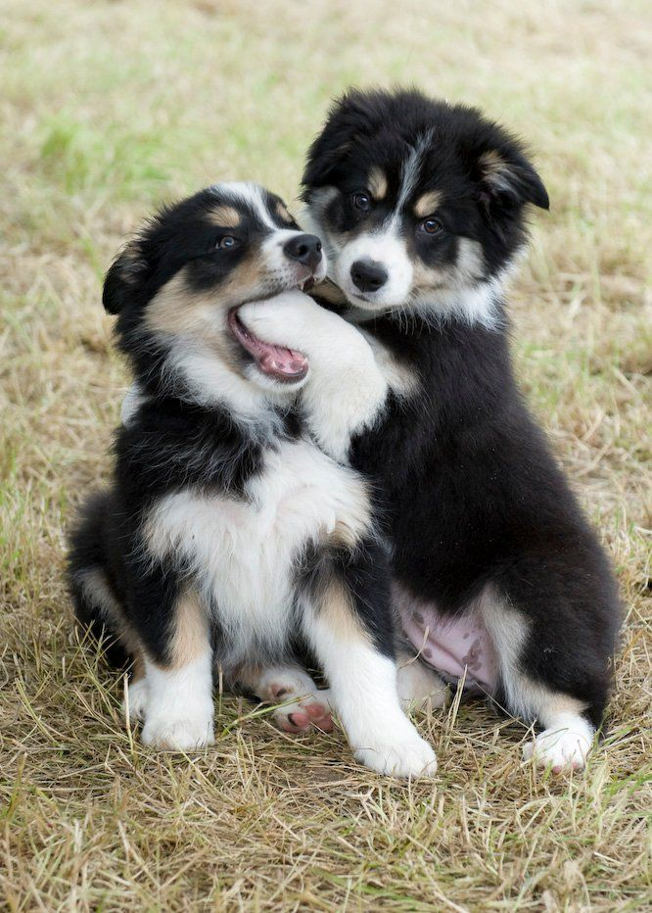
Personality
Border Collies
Friendly
Bring others together
Adored
Smart

Slide 16

Brand Traits
Focused on directness
Trustworthy
Exciting for the new possibilities a user could experience
Comforting in design
Simplistic in design
Encouraging of connection
Personable

Slide 17

Voice
Inviting
Friendly
Clean
The voice shines in that it is trustworthy, yet exciting and implies the possibility of going on an adventure.

Slide 18
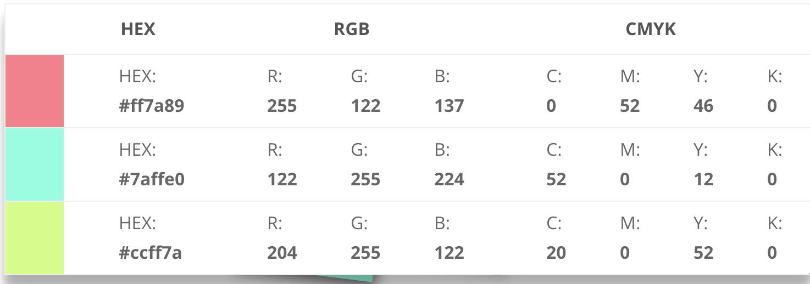
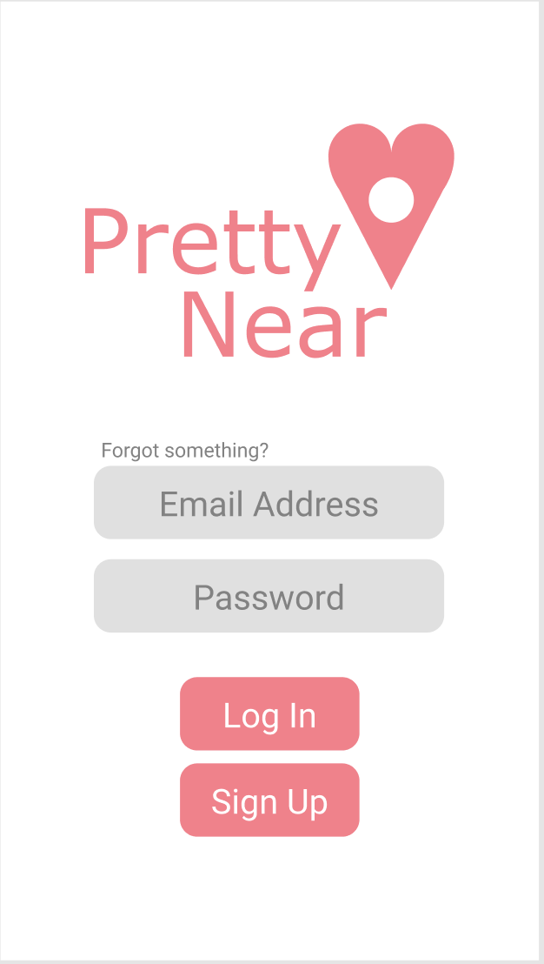
Visual Lexicon
Warm and exiting colors
Simple, efficient, and comforting typography
An overall minimalistic style

Slide 19
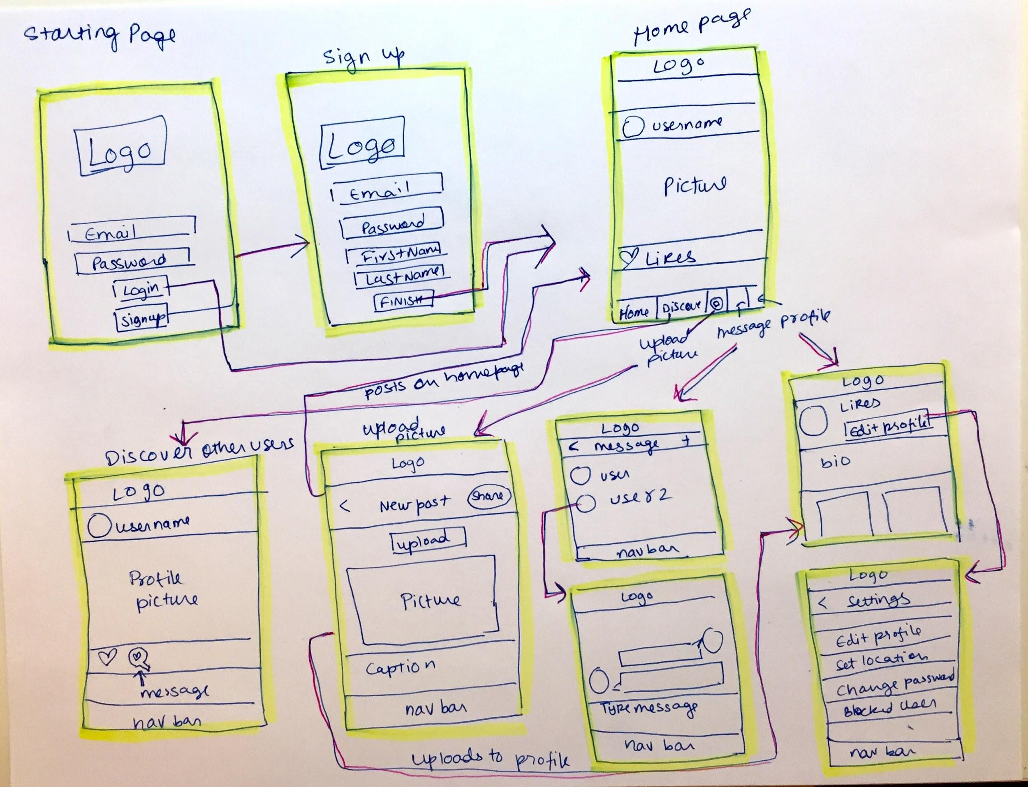
Low fidelity wireframe

Slide 20
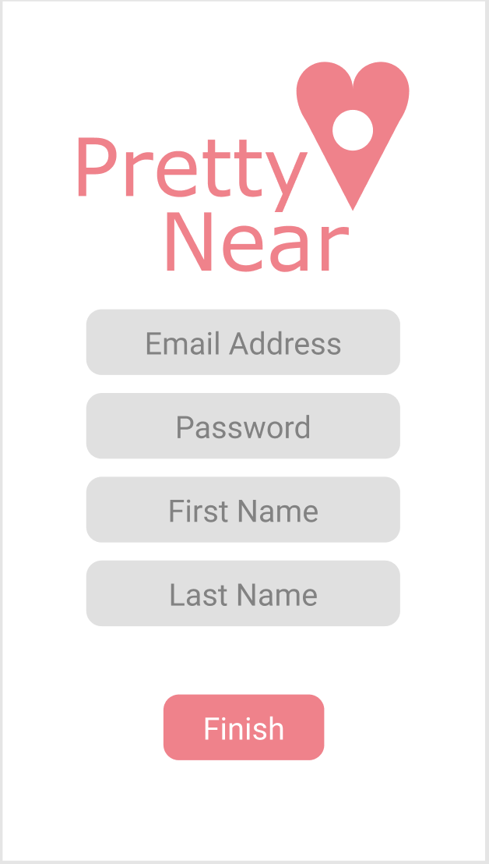
Starting Page - Sign Up and Log In

Slide 21
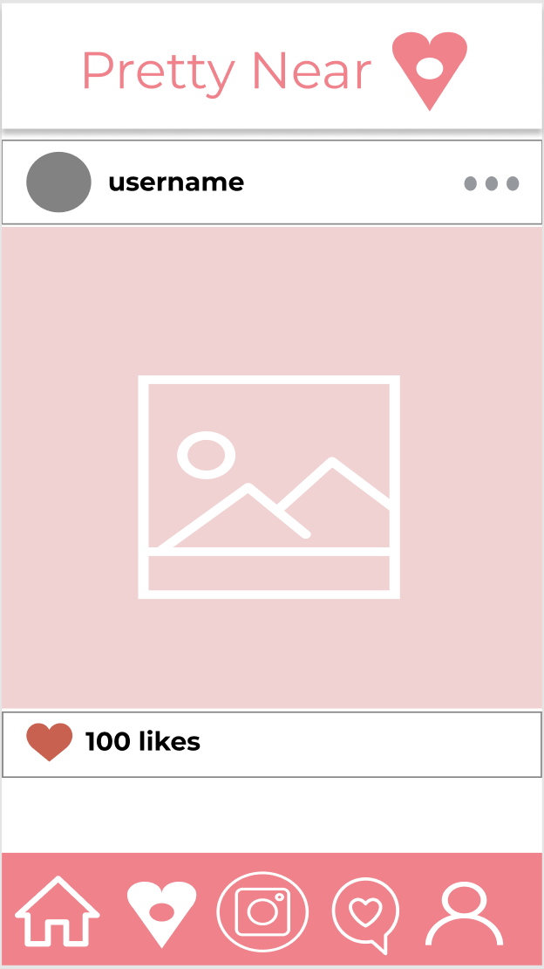
Home Page

Slide 22
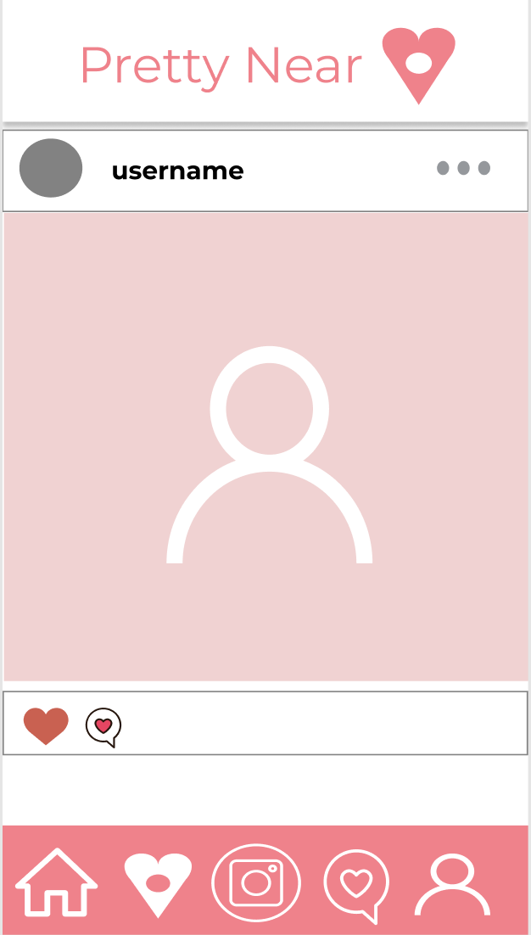
Discover Page

Slide 23
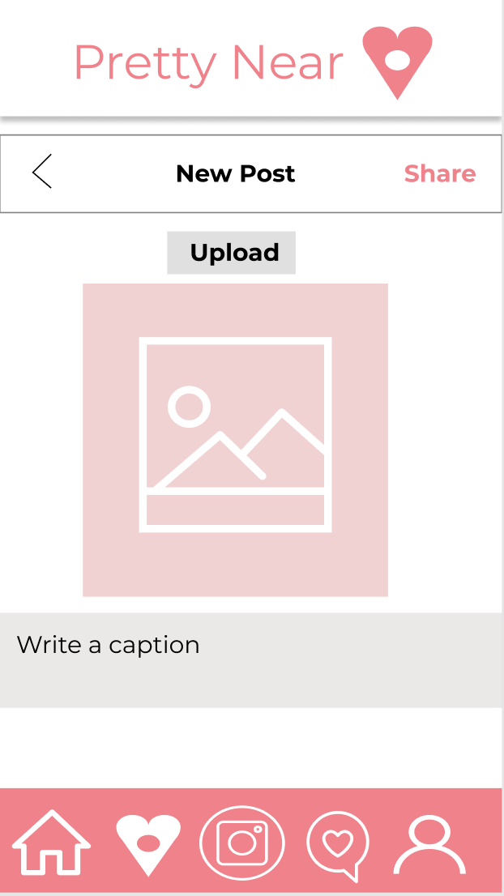
Add a Post

Slide 24
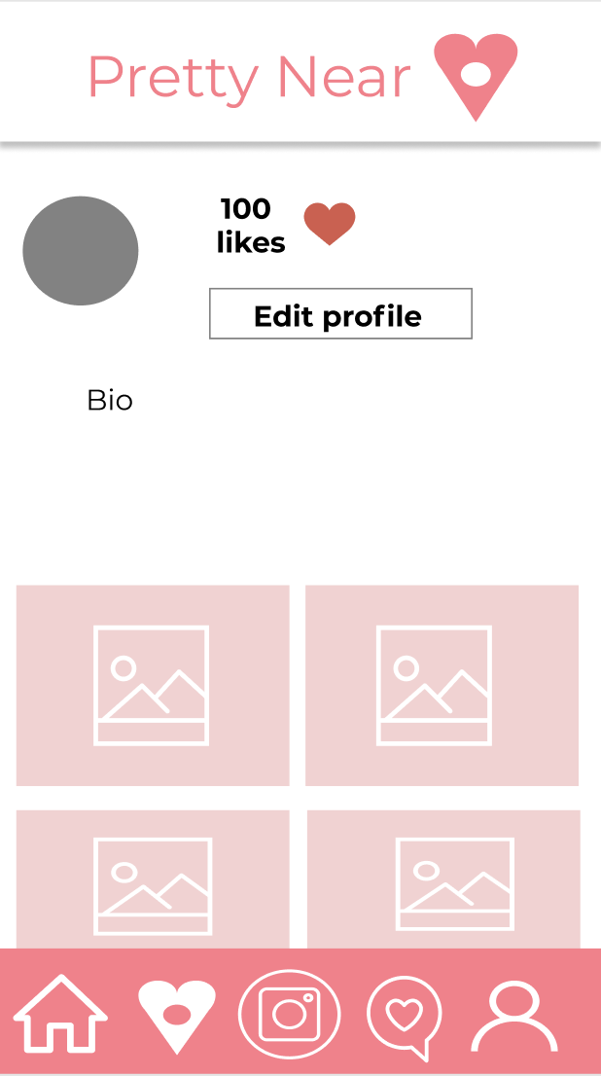
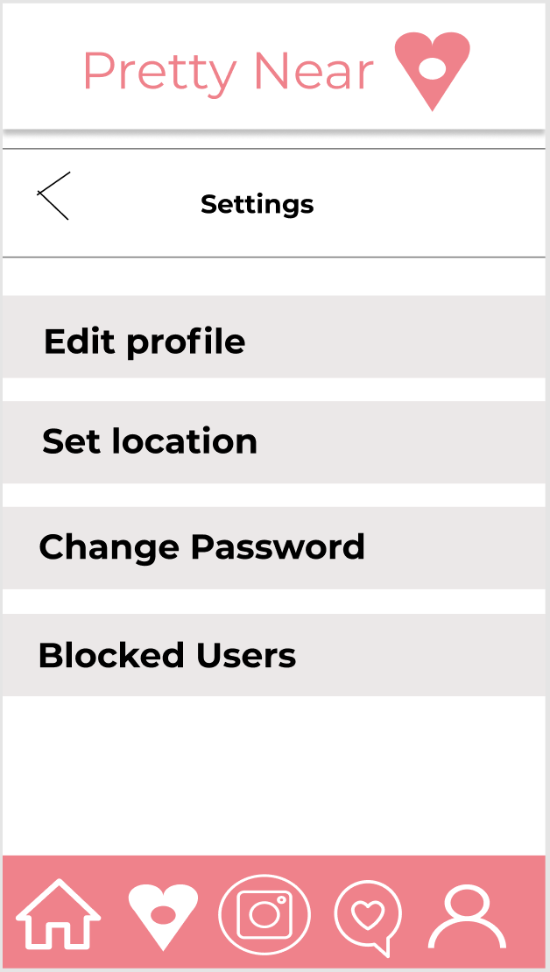
Profile and Setting

Slide 25
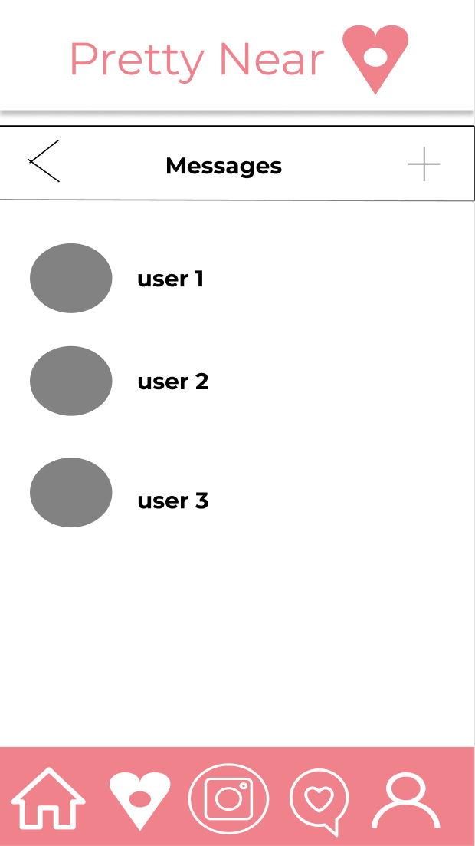
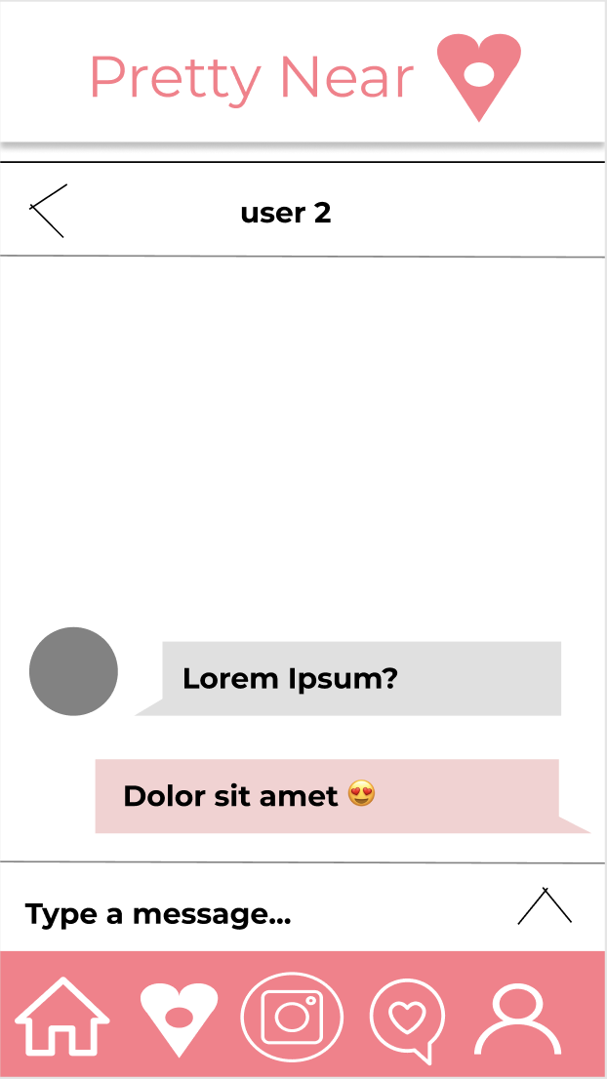
Message

Slide 26
Milestone 2
Database Schema

Slide 27
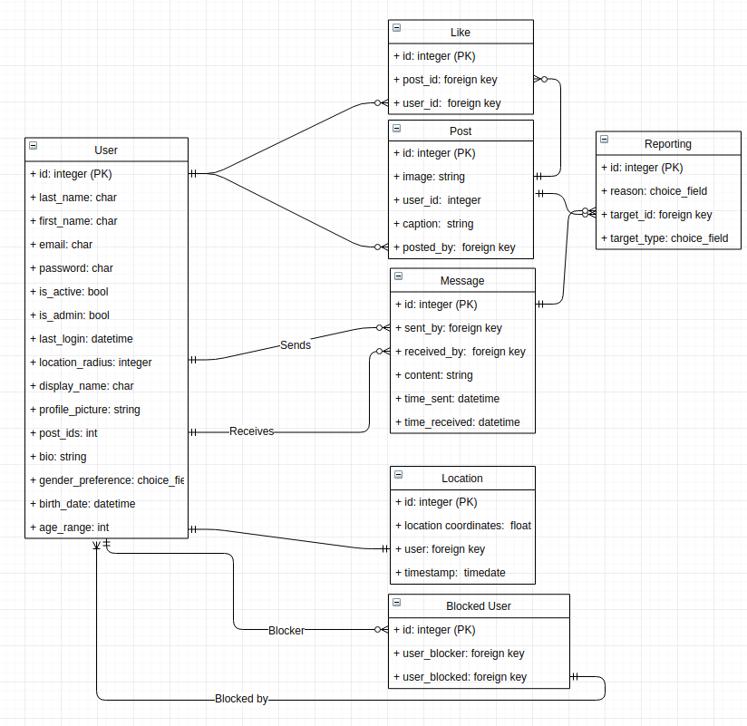
Database Schema
Used foreign and primary key constraints to enforce data integrity
Most foreign keys in database are using Django’s CASCADE option
Ex: If a Post is deleted all Likes are deleted with it

Slide 28
Database Schema
Sample query to display all users in database
SQL Syntax:
SELECT * FROM User;
Django QuerySet Syntax:
users = User.objects.all()

Slide 29
Milestone 2
Demo

Slide 30
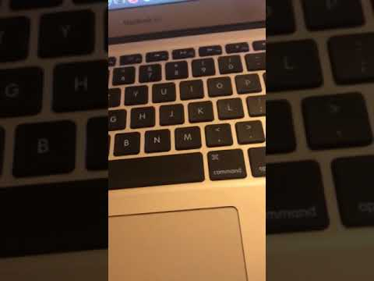
Sign in and
Profile Update

